Slide 1

Year 9 Options
2024-2026
Guidance for the successful selection of GCSE courses

Slide 2
Year 9 Options
Dear Parents and Carers
The following slides are designed to support you and your child in making the right decisions regarding GCSE/BTEC courses.
We want you to feel confident that you have all necessary information and support to make this process as easy as possible.
We want you to know that as your child begins the transition to Year 10 and the start of GCSEs, we will make every effort to ensure it is a smooth one.
Underpinned by our core values: Traditional Values, Learning for the Future and Outstanding Personal Achievement, we endeavour for your child to continue to flourish and be The Best They Can Be.

Slide 3
Key Dates
Week beginning Monday 5 February 2024 (Year 9 Options Launch Week)
Options Booklet, Options Form and additional information sent out to parents/carers.
Options booklet and additional information available on school website.
Thursday 8 February 2024
Options Fayre 4-6pm (an opportunity to speak to subject staff about courses)
Thursday 8 February – Friday 9 February
Year 9 ‘Drop Down’ – an introduction to Options, Unifrog and careers presentation with Chelmsford College.
Monday 4 March 2024
Deadline to submit completed Options Form
Please do not be late – we will process all forms received by the deadline before any that are received late. If you hand in your form late, you risk the chance of disadvantaging yourself.
June-July 2024
Key Stage 4 option subjects will be confirmed to students and parents/carers.

Slide 4
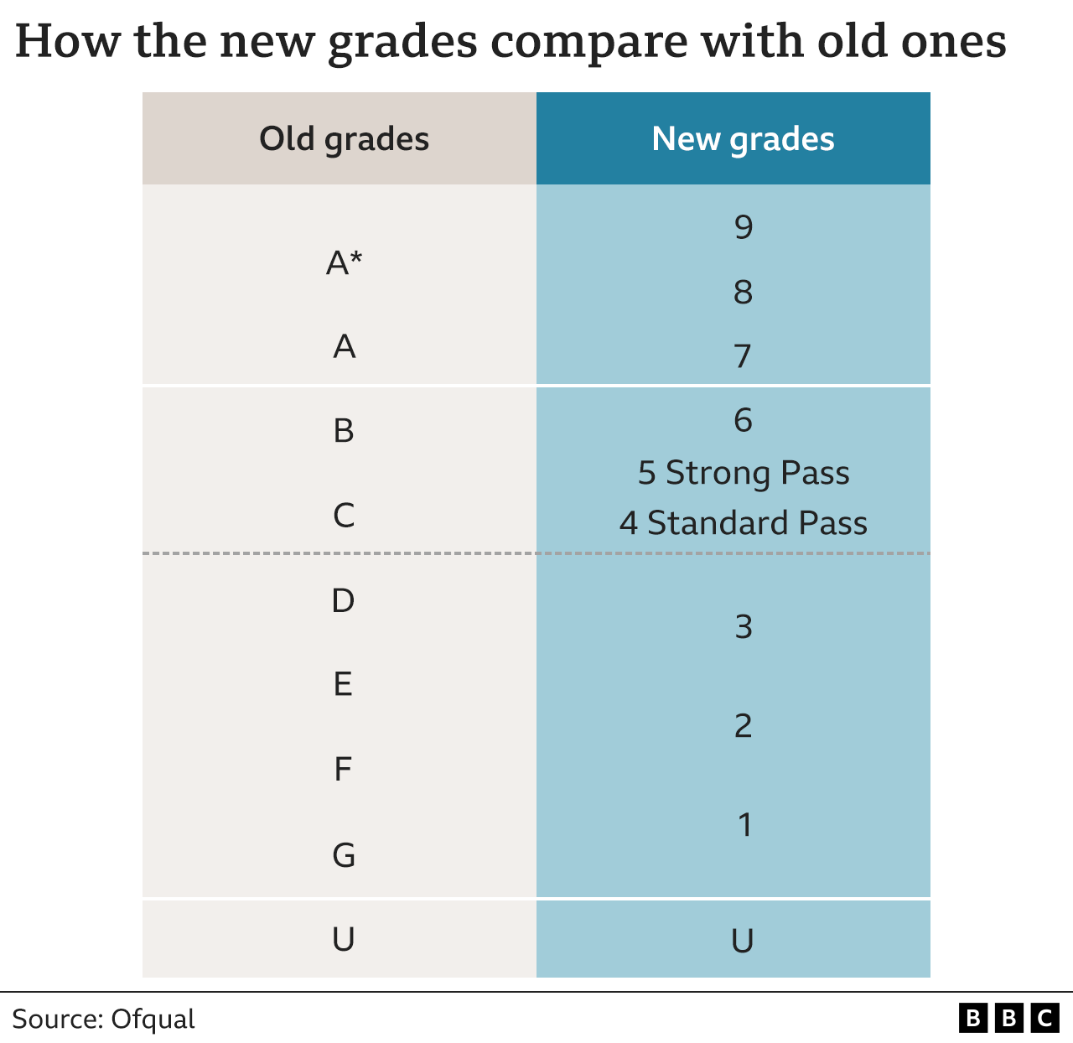
GCSE Examinations
Understanding the grades
If this process is being undertaken by your eldest child, you may not be familiar with the new GCSE grading process that was introduced a few years ago.
The chart opposite can be used for comparison purposes.
A ‘standard pass’ is generally the minimum requirement to enter post 16 courses. However, many institutions will be looking for ‘strong passes’ and you will often need a higher grade in the subjects you wish to study at A level/BTEC.

Slide 5
The Ebacc
The Department for Education recommends these core subjects which make up the English Baccalaureate (Ebacc) and help keep options open for young people:
English Language and English Literature
Mathematics
Sciences (Combined Science or Triple Science, Computer Science)
History or Geography
A modern foreign language
WHAT IS THE EBACC? The EBacc is not a qualification in its own right. It is a combination of GCSE subjects, including a language, that offer an
important range of knowledge and skills to young people.
EBACC FUTURE PROOFS YOUR CHILD’S PROSPECTS.
For more information about the EBacc, please read the leaflet on our website here:

Slide 6
What should I do first?
1. Read the Options Booklet
The Options Booklet provides detailed information about the options process, as well as all the Key Stage 4 courses on offer.
2. Look at your last report
Use this information to guide your decisions. Think about where you are making good progress, what you enjoy and where your strengths lie.
Look at your Attitude to Learning grades. Grades 1 and 2 suggest you engage well with your learning.
3. Have lots of discussions.
What do you enjoy? What subjects might you like to take in the Sixth Form? Do you want to go to university? Complete an Apprenticeship? What might you want to do as a career? Do you want to keep your options open?
A piece of advice – don’t make decisions on the options you choose based only on the teachers you like or because your friends might choose it. The timetable for next academic year is not written yet and we do not know which teachers will be teaching Year 10 at the moment.
4. Research
Research potential careers and the qualifications you will need using Unifrog. Look at entrance requirements for our sixth form.

Slide 7
St Martin’s Sixth Form
We know many of you are looking forward to attending our Sixth Form in two year’s time.
Learning at St Martin’s is not just about academic qualifications – it is about developing you as a whole student and ensuring you go on to excel in every aspect of your future life.
Academic excellence is just as important as social development – all areas we take pride in and hope you will develop across a seven year journey learning with us.
Here in our Sixth Form, we aim to develop the whole person and many of the wider skills needed in life. These include: student leadership, subject ambassadors, public speaking, charity fundraising, mentoring and working with the wider community.
Our vision for each Sixth Form student is that they are ‘confident, resilient and motivated’. We make sure we know every child and are there to guide and support them on the pathway from childhood to self-realisation as a young adult so that they become the Best they can Be.
On the next two slides you will find the current entry requirements for our Sixth Form.

Slide 8
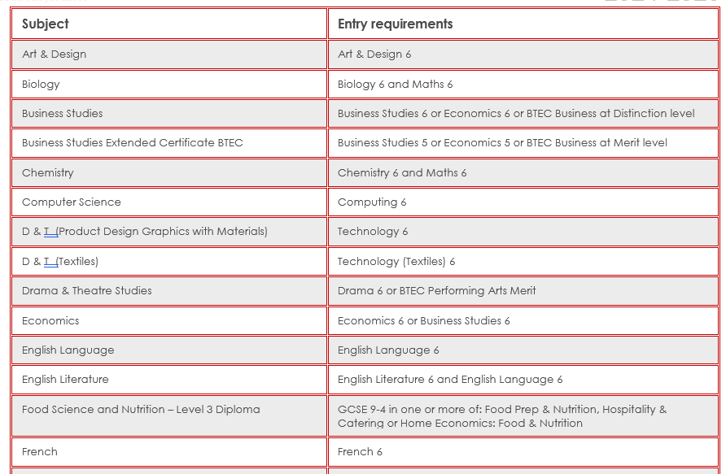
Sixth Form Entry Requirements

Slide 9
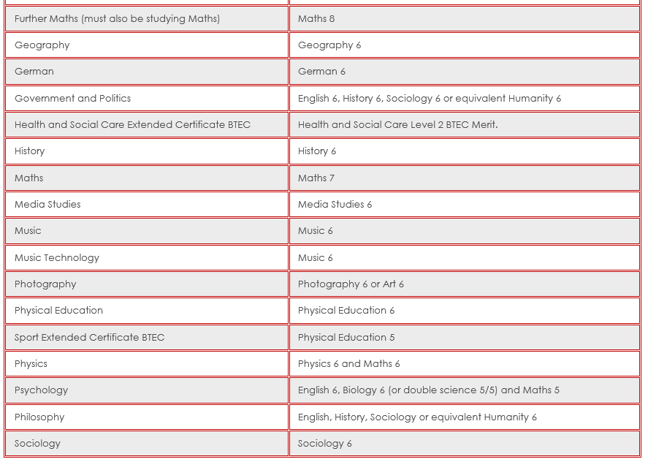
Sixth Form Entry Requirements

Slide 10

Unifrog
Unifrog is an on-line careers platform for students. It offers a one stop shop where students can easily explore their interests, then find and successfully apply for their next best step after school.
Unifrog helps you explore your key interests and what career paths you can take to reach your goals.

Slide 11
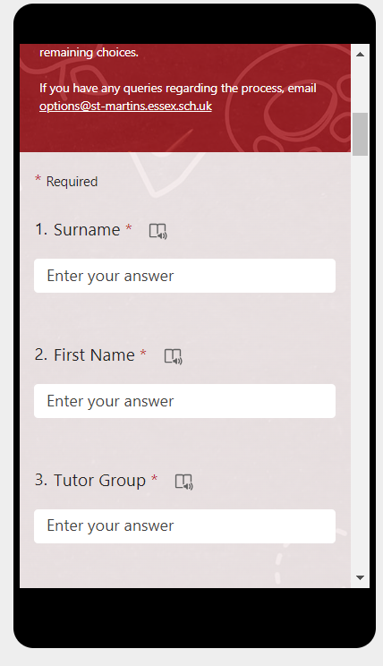
Completing the Options Form
Please read each section of the form and follow the instructions provided.
We will do our very best to meet your preferences, but please be aware that in some cases, this may not always be possible. In these cases, we will look at your reserve choices.

Slide 12
Completing the Options Form
Please complete the Microsoft Form by Monday 4 March.
Information regarding option
preferences will be issued by July 2024.

Slide 13

Support
Guided Options Booklet
Unifrog
Internet
Teachers
Family/Friends

Slide 14
Communication
If you have any queries or would like further advice regarding options, please email:
options@st-martins.essex.sch.uk
Please note, all students with Special Educational Needs will be contacted by the SENDCo to discuss and support the decision-making process.

