Slide 1
Parents guide to revision
Year 11 PPEs December 2021
Be The Best You Can Be

Slide 2
How can I help my child to revise?
Show an interest but try not to nag. Their way of learning things may not be the same as yours, but it doesn’t matter as long as they learn.
Revision is best if it is active. Remind your child to do more than just read notes or watch revision videos. The evidence is that revision works best when students summon information from their memory.
Offer to be a revision buddy and ask them questions. If they work with friends, ask how they are revising together to check it’s active learning.
Get them to teach you the topic – if you can learn, they really know it! The important thing in the exam is what they can show they know.
Encourage them to write examination answers and get them to check their marks with the mark scheme.
Be The Best You Can Be

Slide 3
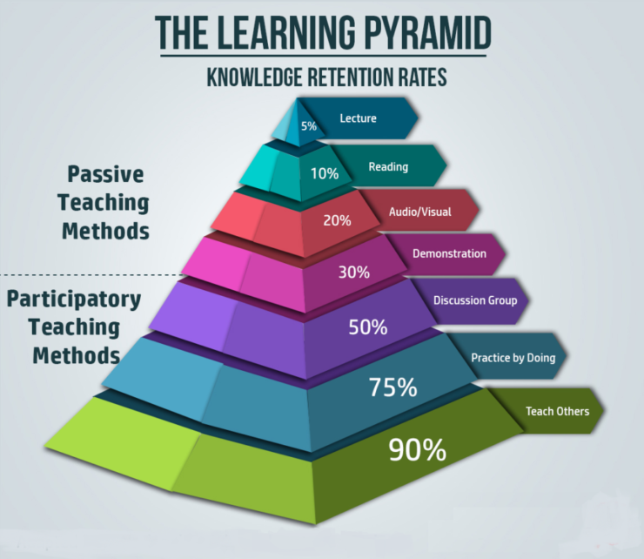
Be The Best You Can Be

Slide 4
Repeat, repeat, repeat
Be The Best You Can Be

Slide 5
Revision techniques to try
Some of these seem odd to those who don’t use them but each one works for some people. We all learn in different ways. It’s a matter of experimenting to see what works for your child.
Revision timetable
The secret with a revision timetable is
to not spend more time planning it than doing it! Put the date of exams in first, then ‘reward time’, then plan two out of three sessions a day. Put a copy of the exam timetable where it can be seen. Tick off exams as they are taken.
Subject revision planner
Divide a piece of A3 paper (or two A4 sheets
stuck together) into three columns.
Cue cards
Postcard size cards. Question on one side, answer on the
other. Good for content-based subjects like science.
Left column - not known. Middle column - learning. Right column - known.
Why this works:
Making them is a reminder of what to learn. Writing questions also helps learning.
They are portable. You can revise on the bus, in the car, in the park, on the beach etc.
A partner can hold up the card with the question facing the student and read the answer on the back.
The student can read the question and turn the card over to check the answer.
The student can mark the card with a tick every time s/ he gets the answer right. Five ticks and it is learned.
Cards can be sorted into ‘learning’ and ‘known’ piles. The ‘learning’ pile can be gone through every day. The
‘known’ pile can be gone through once a week.
Write topic headings on post-it notes and put them in the appropriate column. As they learn each topic, they move it to the right until all the topics are in the ‘known’ column.
Why this works:
It tells the student what to revise (not known first, then learning) and how they are progressing.
It shows what they already know.
Be The Best You Can Be

Slide 6
Revision techniques to try
Mind mapping
Mind maps are good for people who remember
visual images well. The topic is the central idea
- add branches to show the different sections of the main topic, then use colour and images to make it more memorable.
Mnemonics
Mnemonics are useful for remembering lists or
sequences, for instance ‘Richard of York Gave Battle in Vain’ for the colours of the rainbow.
Why this works:
The mnemonic is a memorable sentence or phrase and easier to remember than a list of words. Research shows they work best if students make up their own – and the sillier the better!
Why this works:
Students who remember visual images well will remember the colours / shapes / pictures in the mind map they have drawn and can redraw all or part of it in the exam to help with planning answers.
Be The Best You Can Be

Slide 7
Revision techniques to try
Teaching someone else
Evidence shows revision works best when
students finish by having to recall information from their memory in a different way to answering exam questions. A good tactic for this is for a student to teach it to someone else.
Answering examination questions
Find past papers and answer the questions in the
time allowed. Exam boards have copies of past papers online with the mark schemes.
Why this works:
If you can teach it, you have to know the topic very well. You not only have to recall information, you also have to work out how to tell someone else about it in a way which helps the other person learn.
Why this works:
Research shows producing information from memory is the best revision.
Some subjects, like English Language, are about producing responses like a letter or an essay and not about learning facts. This is what has to be done in the exam. It’s the only way to let the examiner know what the student knows.
Be The Best You Can Be

Slide 8
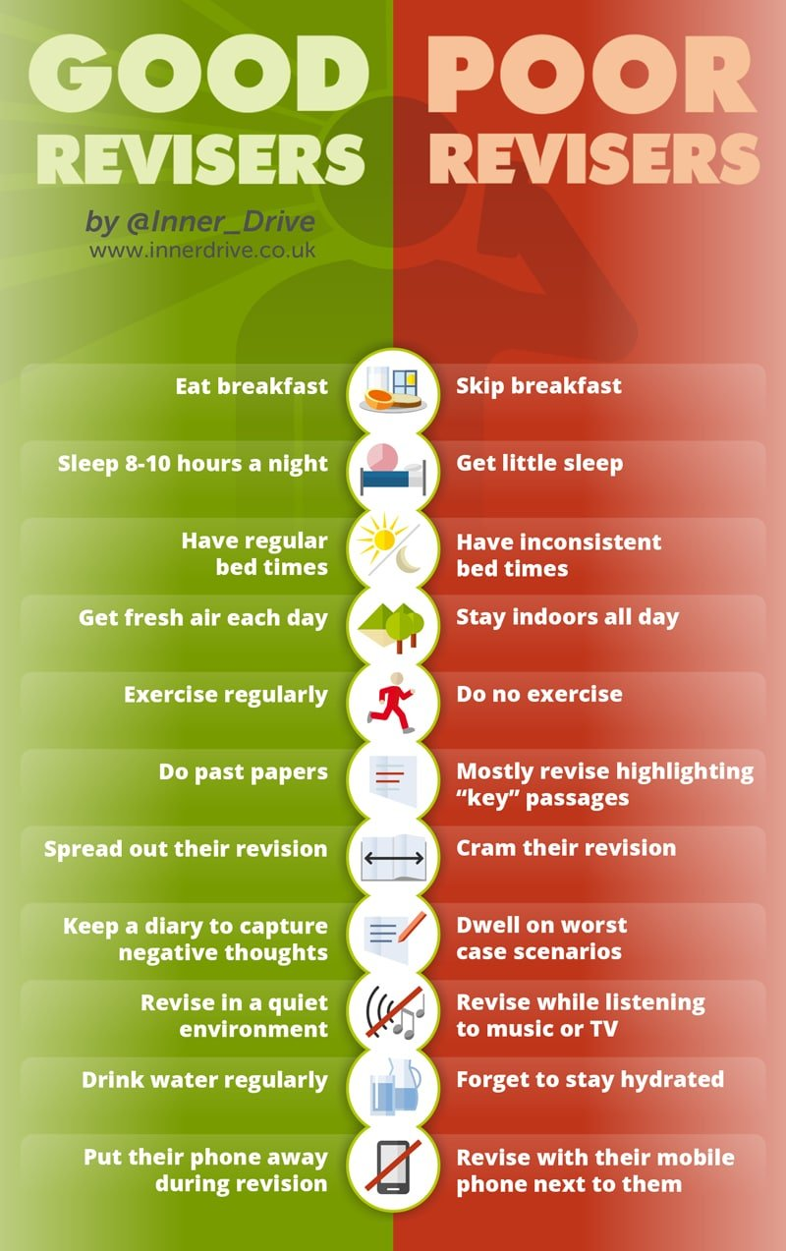
Be The Best You Can Be

Slide 9
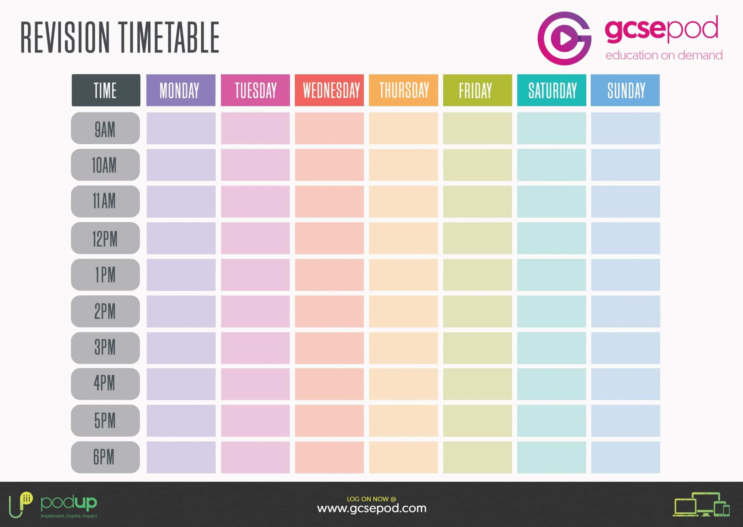
Subject
Topic
Method
25 mins revision; 5mins break.
Be The Best You Can Be

