Slide 2
Learning objectives
Describe the impact of bullying and discrimination against LGBT+ people
Describe how people have stood up for equality and how we can all stand up to bullying
Build confidence in challenging discrimination in school

Slide 3
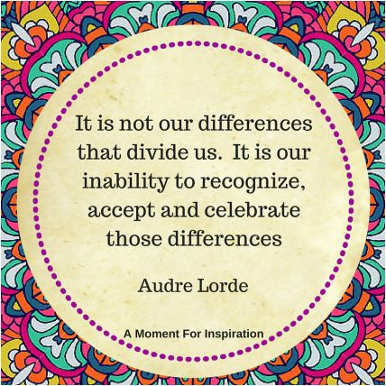
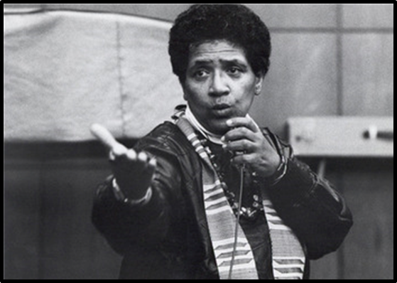
All different, all equal
Notes:
1min
Show Audre Lorde quote
What does she mean in this quote?
What things make us all different?

Slide 4
LGBT+
L
G
Gay:
B
T
Heterosexual
Bisexual: someone who can be attracted to more than one gender (e.g. men and women)
Transgender:
Lesbian:
Heterosexual:
a man who is attracted to women OR a woman who is attracted to men
a person whose gender identity is different from the sex they were assigned at birth
a man who is attracted to men OR a woman who is attracted to women
a woman who is attracted to other women
Why do we have a “+” after LGBT?
Notes:
4m
Get students to read LGBT+ definitions. When explaining Transgender make sure you explain the difference between sexual orientation & gender identity: sexual orientation is about who you love/are attracted to whereas gender identity is about what gender you identify with – so it is possible to be transgender and straight/gay/bi etc. We discuss them together because LGB & T people often experience similar challenges for ‘being different’.
Why is there a +? More gender identities and sexualities than LGB and T e.g. asexual – experiencing little or no sexual attraction
Does anyone know the word for bullying or discriminating against lesbian and gay people? Transgender people? Bisexual people? Homophobia, transphobia and biphobia.

Slide 5
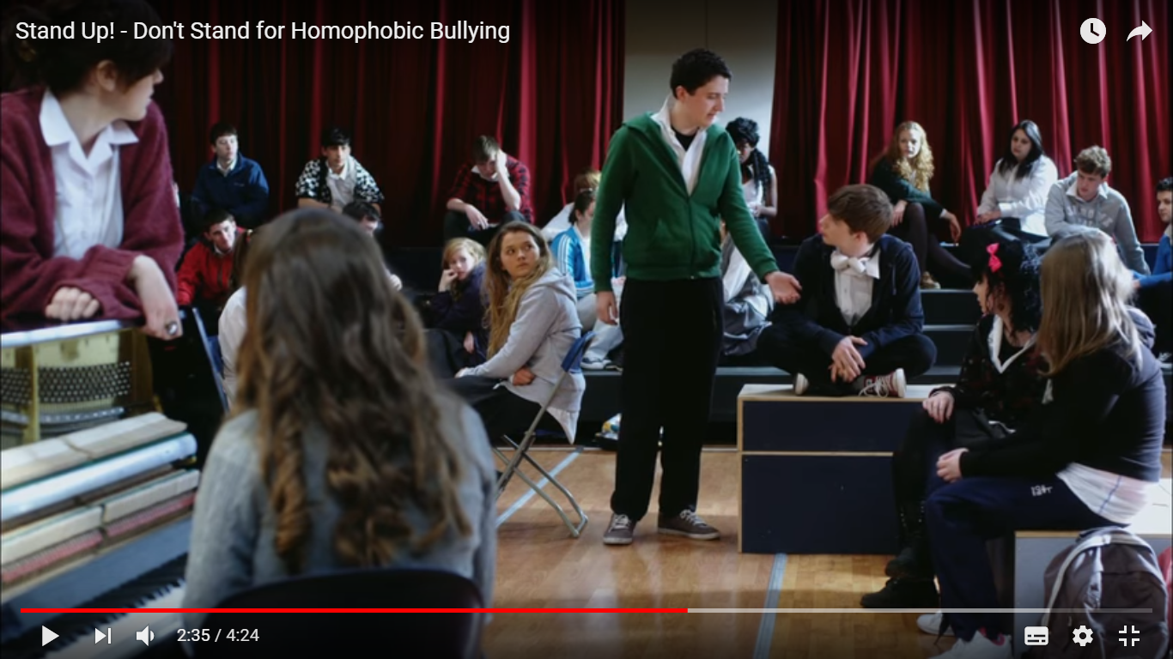
Stand up
Notes:
https://www.youtube.com/watch?v=lrJxqvalFxM
5m
Show film

Slide 6
Questions
How do you think the boy felt when the bullies were mocking him for his sexual orientation?
How do you think he felt when his classmates stood up against homophobia?
What might the long-term impact of bullying be?
Notes:
5m
How do you think the boy felt when the bullies were mocking him for his sexuality?
How do you think he felt when his classmates stood up against homophobia?
What might the long term impact of bullying be?
Draw out long term impact on attendance, attainment, well-being, confidence and mental health.

Slide 7

Talk to the person next to you about a time you stood up for someone or someone stood up for you.
Notes:
3m
Model an example of you standing up for someone and someone standing up for you. Explain that this can be supporting as well as challenging.

Slide 8
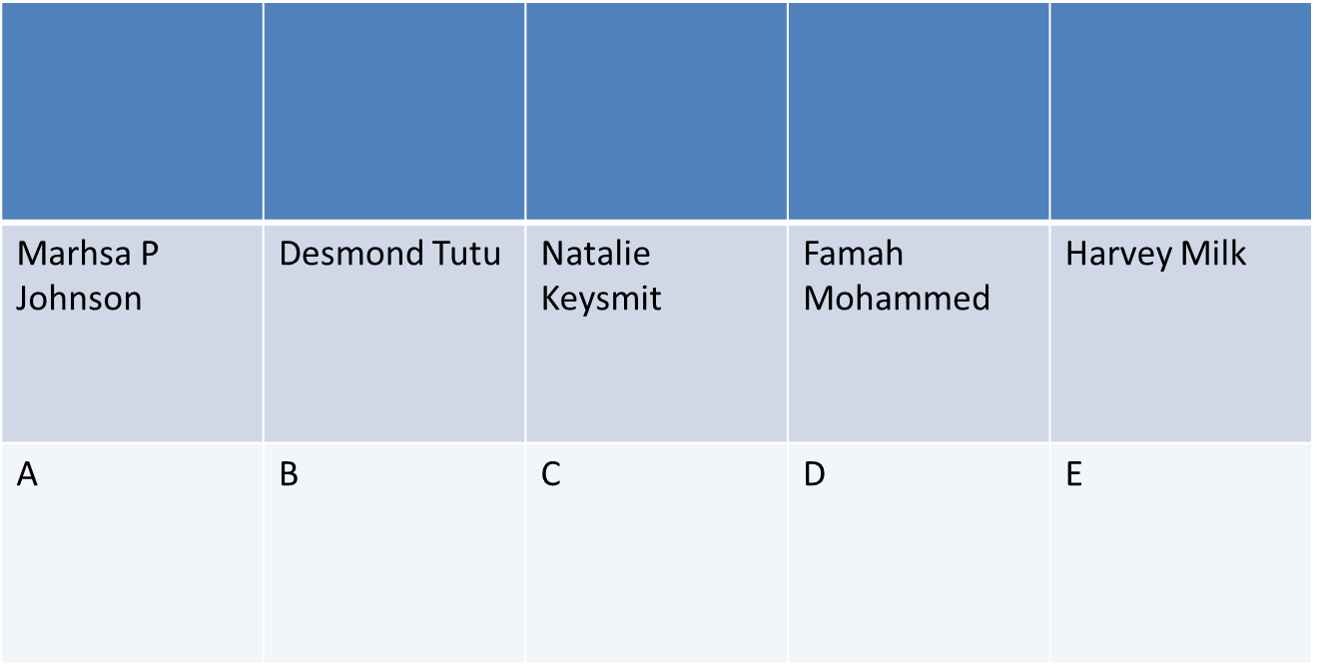
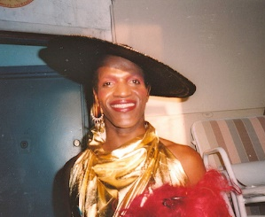
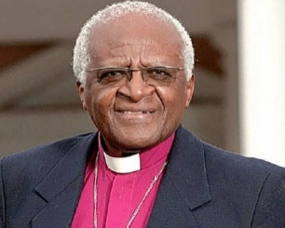
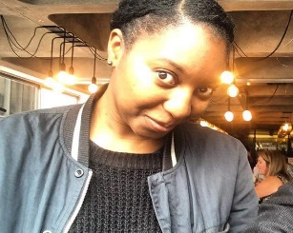
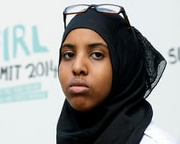
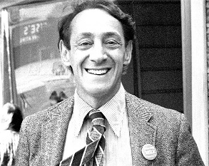
In pairs, circle the letter representing the person you think the statement is about or the quote is from.
Clue: there are two statements and one quote from each person
Notes:
10m
Standing up for equality activity: Hand out the activity sheet and ask students to decide which person the statement relates to or quote is from. There are two versions for differentiation. Go through answers and then share slides about each person.

Slide 9
Standing up for equality
At the age of 14 I started campaigning to end FGM, a process where girls are illegally operated on to remove part of their genitalia.
My campaign won its goal of getting compulsory training for teachers, doctors and social workers to help them identify and assist girls at risk.
“It was fighting against something people were in denial about, it was hard for people to understand our point of view and for people in the community to be able to come out and say I am against this, too.”

Slide 10

Standing up for equality
I organised protests and campaigns that helped bring an end to Apartheid, a policy of discrimination by the South African government against black people.
I won the Nobel Peace Prize and have stood up against poverty, racism, sexism, HIV/AIDS, tuberculosis, homophobia, and transphobia.
“Homophobia is a crime against humanity and every bit as unjust as apartheid”

Slide 11
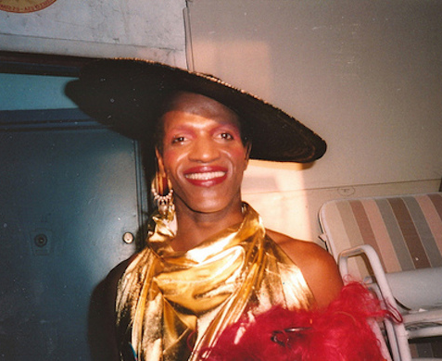
Standing up for equality
Stood up to police harassment of LGBT+ people at the Stonewall Inn, New York 1969 leading to riots which sparked the campaign for LGBT+ rights across the world.
Helped organise one of the first ever Pride marches as well as other protests and marches for LGBT+ rights.
“How many years does it take for people to see that we're all brothers and sisters and human beings in the human race?”

Slide 12

Standing up for equality
I was the first openly gay elected official in the history of California, USA.
After I was elected I supported a bill that made it illegal to discriminate against people on the basis of their sexuality.
“All young people, regardless of sexual orientation or identity, deserve a safe and supportive environment in which to achieve their full potential”

Slide 13

Standing up for equality
When I was in Year 11 my friend Arif wrote me a letter to tell me he was gay. I stood up for him by letting him know that I was still his friend and that it makes no difference who he loves – this helped him grow in confidence and be happy being himself.
I have continued to support the LGBT+ people in my life and make sure that I stand up for LGBT+ rights whenever I can.
“Friends are some of the few people that should understand you and give you license to be yourself and make an effort to understand your difference without trying to change you.”

Slide 14
Which of these was most inspiring to you?
Notes:
Discuss in pairs

Slide 15
Are there any other people who have stood up for equality who inspire you?
Notes:
Group or class discussion

Slide 16
What are the issues facing LGBT+ people in school?
Notes:
4m
Now that we’ve looked at what people have done to stand up for equality, think about what we can do. But, important we first understand what we are standing up against.
Flipchart and small groups.

Slide 17
What next?
How can we stand up for LGBT+ people at school?
Think …
What can you do?
What can teachers do?
Notes:
4m
Same small groups. Flipchart.

Slide 18

Time to act!

Slide 19

Role play scenarios
You overhear your friends joking and laughing about someone in the year above who has come out as transgender. How should you respond?
Someone calls your friend “gay” as an insult because she likes football. What could you do?
Notes:
5m
In pairs. If there is lack of time split the class and one half looks at first scenario and other half the second. Get a few students to share their role plays

Slide 20
Pledge for equality
I will…
I pledge to..
I will stand up by…
www.themix.org.uk
www.switchboard.lgbt
Notes:
3m
Model a pledge you will make for making the school more inclusive e.g. make more inclusive lessons
Hand out a post it or piece of paper. Students write their personal pledges about what they will do to stand up for LGBT+ people. Students can read their pledges in pairs or to whole class.
Teacher collect in and place in a display.
The Mix has information and forums discussing a range of issues
Switchboard is a free and confidential phoneline and instant messaging service for people wanting to talk about anything related to gender identity or sexuality

Slide 21
www.diversityrolemodels.org
info@diversityrolemodels.org

